Slide 1
Y7 Summer | Week 4 | Day 1

Slide 2
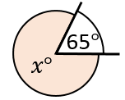
Y7 Summer | Week 4 | Day 2

Slide 3
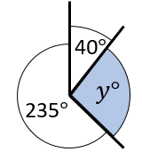
Y7 Summer | Week 4 | Day 3

Slide 4
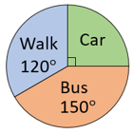
Y7 Summer | Week 4 | Day 4

Slide 5
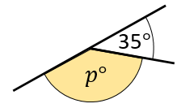
Y7 Summer | Week 4 | Day 5

Slide 6
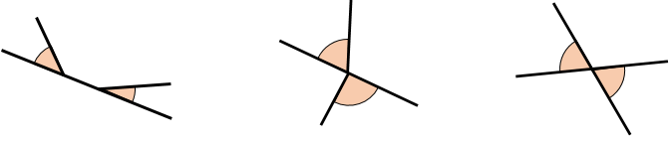




Y7 Summer | Week 5 | Day 1
A
B
C
$$x°$$
$$x°$$
$$x°$$

Slide 7
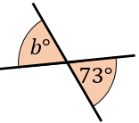
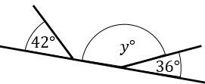
Y7 Summer | Week 5 | Day 2

Slide 8
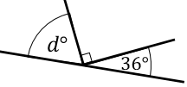

Y7 Summer | Week 5 | Day 3

Slide 9
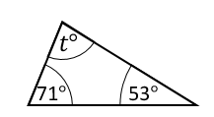

Y7 Summer | Week 5 | Day 4

Slide 10
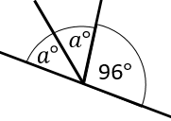
Y7 Summer | Week 5 | Day 5

Slide 11
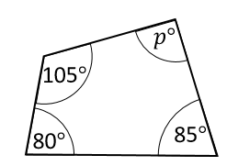

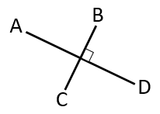
Y7 Summer | Week 6 | Day 1

Slide 12
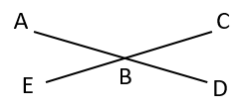
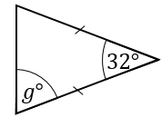
Y7 Summer | Week 6 | Day 2

Slide 13
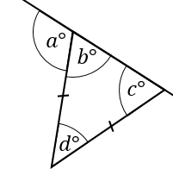
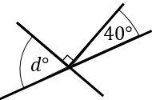
Y7 Summer | Week 6 | Day 3

Slide 14
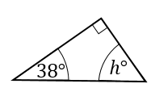

Y7 Summer | Week 6 | Day 4
Input
Output

Slide 15
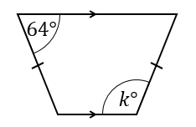
Y7 Summer | Week 6 | Day 5

